Slide 1

Risk-Aware Planning for Autonomous Driving
Jiaqi Xie
25027138
Notes:
Cover title slide layout features a full background image with a main heading positioned in the top left corner on a dark purple panel. The presenters’ names and the date sit beneath the title. The UCL logo is placed in the bottom right corner of the slide.

Slide 2
Area of Research: Motion Planning under Uncertainty
Autonomous driving requires a vehicle to perceive the environment, predict other road users, plan a safe trajectory, and control its motion.
This project focuses on motion planning under uncertainty:
how the ego car decides a safe action when another vehicle may slow down, continue, or move differently.
Scenario
Perception
Prediction
Planning
Control
Results
This is not about detecting objects.
It is about turning uncertain predictions into safe driving decisions.
Notes:
Content slide with a headline at the top left, followed by text box beneath it.

Slide 3
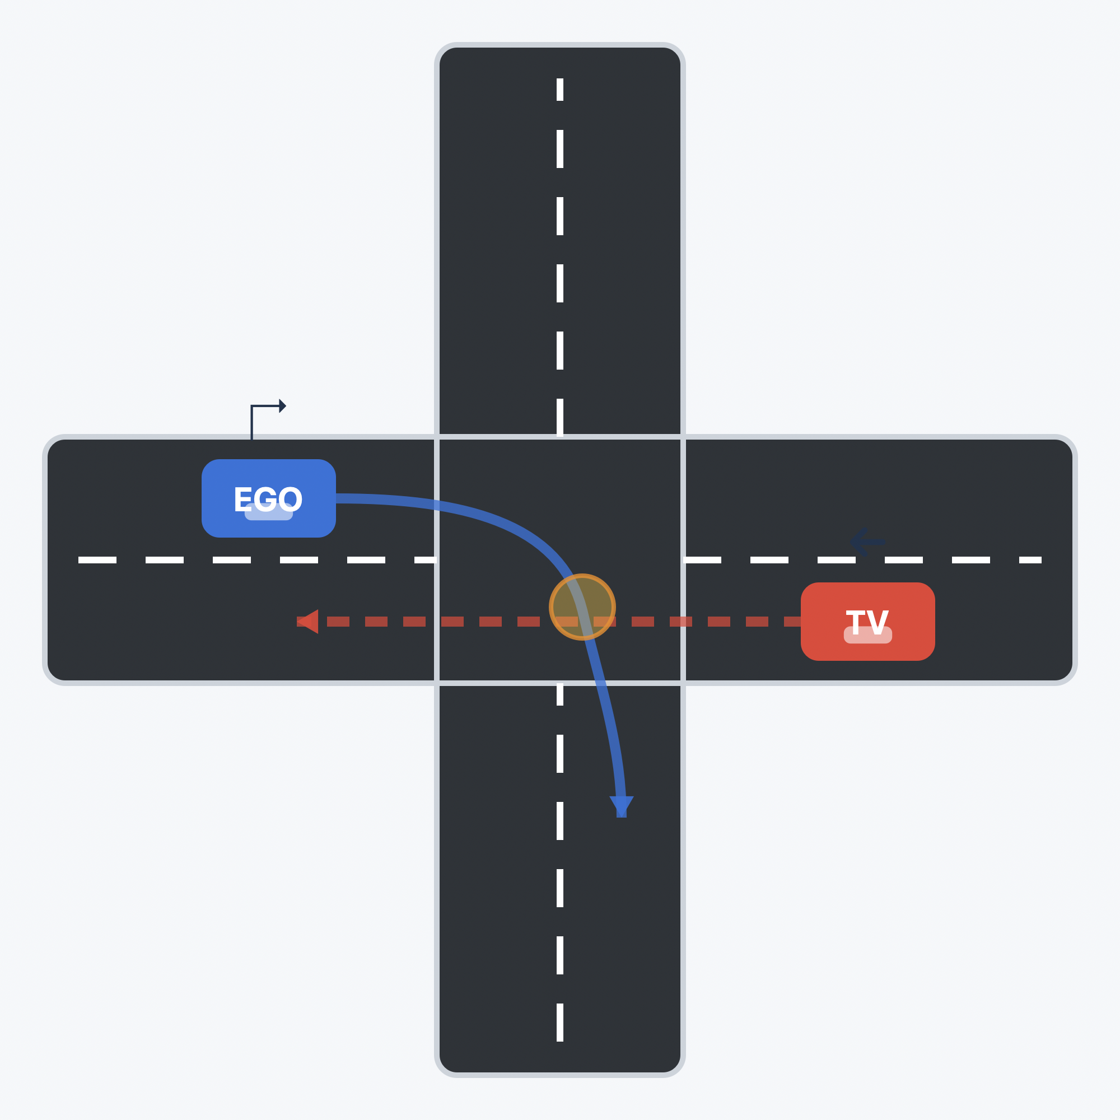
Problem: Crossing an Intersection Safely
The ego vehicle must cross an intersection while another vehicle may behave in different ways.
The target vehicle may continue, slow down, or move slightly differently from what is expected.
The decision must be updated repeatedly as new observations arrive.
Like crossing a road: look, think, then move.
This is a sequential decision-making problem under uncertainty.
Notes:
Content slide with a headline at the top left, followed by text box beneath it.

Slide 4
Core Problem: One Predicted Future Is Not Enough
If the planner trusts only one guessed target-vehicle trajectory, it may:
choose an unsafe action
stop too conservatively
or fail to make progress.
One guessed future
Several possible futures
EGO
TV
EGO
TV
Too confident
Risk-aware
The research problem is:
how can the car use multiple predicted target-vehicle trajectories to choose a safe action?
Notes:
Content slide with a headline at the top left, followed by text box beneath it.

Slide 5
Significance: Safety Requires More Than Stopping
Intersections are high-risk scenarios because vehicles interact closely and decisions must be made quickly.
A useful planner must balance three goals:
Safety
avoid collision
Progress
avoid unnecessary stopping or hesitation
Comfort
avoid sudden braking or steering
This is worth prioritising because prediction errors become real safety risks only when they affect the vehicle's action.
If solved, the vehicle can cross complex intersections more reliably without simply becoming over-cautious.
Notes:
Content slide with a headline at the top left, followed by text box beneath it.

Slide 6
State of the Art: From Prediction to Safe Planning
Approach | Contribution | Remaining limitation
Multimodal prediction, e.g. MultiPath | predicts several possible trajectories | does not choose the ego action
Learning-based planners | can learn complex behaviour | hard to guarantee safety and interpret failures
Rule-based safety methods | provide simple safety guarantees | may be too rigid in interactive scenarios
Risk-aware SMPC | plans under uncertainty | can become conservative or infeasible
Remaining Gap:
we need a closed-loop planner that uses multimodal predictions while balancing safety, progress, feasibility, and comfort.
SMPC = Stochastic Model Predictive Control: a planning method that chooses safe actions while accounting for uncertainty.
Notes:
Content slide with a headline at the top left, followed by text box beneath it.

Slide 7
Hypothesis
Research question:
Can a self-driving car cross an intersection more safely by considering several possible futures?
Hypothesis:
Using multimodal predictions in SMPC should keep the ego vehicle safer without making it unnecessarily hesitant.
Success criteria:
Higher minimum distance to the target vehicle.
High solver feasibility.
Reasonable completion time.
Smooth and stable control actions.
Failure condition & Alternative explanation:
If the method is unsafe, infeasible, or only stays safe by stopping too much
Notes:
Content slide with a headline at the top left, followed by text box beneath it.

Slide 8
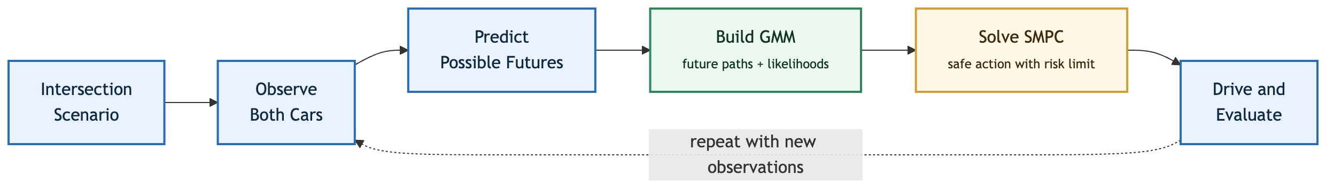
Execution plan
Testing: compare policies
Evaluation: use metrics
No target-vehicle baselines.
ideal path and time
Fixed-risk SMPC.
basic uncertainty handling
Variable-risk SMPC.
adaptive risk-budget allocation
Completion time.
Solver feasibility.
Minimum distance to target vehicle.
Path deviation.
Comfort / jerk.
Computation time.
GMM = Gaussian Mixture Model. It represents several possible target-vehicle trajectories and their probabilities.
SMPC = Stochastic Model Predictive Control. It chooses actions using probabilistic safety constraints.
Notes:
Content slide with a headline at the top left, followed by text box beneath it.

Slide 9
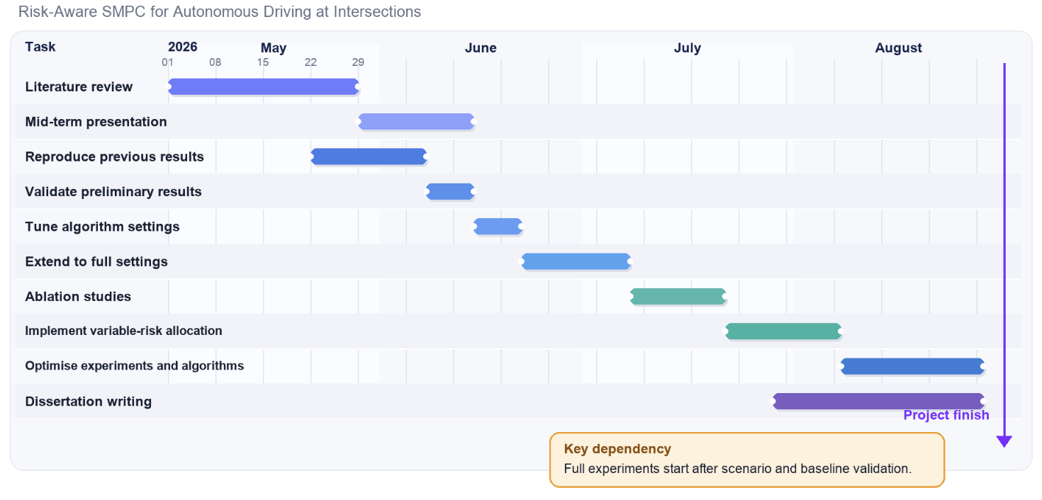
Execution plan: Timeline and Dependencies

Slide 10
Risk analysis
Risk | Impact | Mitigation
Simulator is slow | Experiments take time | Run small pilots first, then scale experiments
Planner fails | Car may produce invalid actions | Save debug logs, use fallback analysis
GPUs from UCL are limited | Experiments may be delayed | Use alternative GPUs such as Google Colab
Results are mixed | Hypothesis may not be fully supported | Analyse failure cases instead of hiding them
The main risk is interpretability:
I need to know not only whether the car succeeds, but why it succeeds or fails.
Notes:
Content slide with a headline at the top left, followed by text box beneath it.

Slide 11
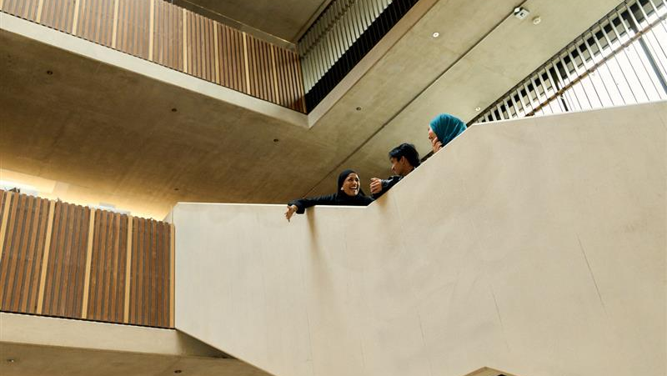

Thank you
Notes:
Content slide full image with full colour logo

